Slide 1




CODE FORGE
G H RAISONI SKILLTECH UNIVERSITY
NAGPUR, MAHARASHTRA
CODE
FORGE
OFFICIAL TEMPLATE
Department of Science & Technology
HACKATHON PRESENTATION
PROBLEM STATEMENT TITLE
Urban Infrastructure Cascade Simulator
TEAM NAME
PROBLEM CODE
TEAM MEMBERS
INSTITUTION
Smasherz
CF-2026-S-03
Tushar Tiple, Smit Patil, Atharva Trinagriwar, Yugal Kalaskar
St.Vincent Palloti College of Engineering and Technology, Nagpur

Slide 2








CODE FORGE
G H RAISONI SKILLTECH UNIVERSITY
The Problem
In Our Own Words
Real-World Context
Industrial IoT networks generate high-velocity telemetry, but current monitoring systems fail to spot multi-sensor drift until catastrophic hardware failure occurs.
Modern automated factories process over 50,000 telemetry readings per second across distributed plant equipment with zero tolerance for unscheduled downtime.
Who Is Affected?
Existing Limitations
Plant reliability engineers, SCADA operators, and industrial maintenance managers who spend hours investigating false alarms and diagnosing latent equipment faults.
Traditional static threshold alerts produce up to 65% false positives, while cloud-only AI incurs high network latency and exorbitant bandwidth costs.
ONE CLEAR PROBLEM STATEMENT
"How to construct an ultra-low-latency, self-adapting anomaly detection pipeline at the edge that eliminates false alerts without manual threshold tuning."

Slide 3






CODE FORGE
G H RAISONI SKILLTECH UNIVERSITY
Problem Decomposition
Core Technical Problem
Key Assumptions
Modeling complex non-linear spatio-temporal correlations between dynamic multi-variable sensors under non-stationary industrial operating conditions.
High-frequency sensor streams are delivered via standard MQTT/gRPC protocols with sub-50ms transmission budget and minimal packet drop.
Known Constraints
Edge Cases & Complexity
Must run seamlessly on resource-constrained Edge IPC hardware (ARM64 / Jetson Nano) within a strict 512MB RAM and sub-15ms inference window.
Handling transient sensor dropouts, intentional physical load spikes, dynamic baseline shifts, and out-of-distribution environmental disturbances.

Slide 4





CODE FORGE
G H RAISONI SKILLTECH UNIVERSITY
Research & Prior Art
Approach / System | Core Methodology | Key Strengths | Where It Fails | Our Identified Gap
Rule-Based Thresholds | Static Min/Max Limits | Zero compute overhead, instant setup | Incapable of capturing inter-sensor dynamics; high false alarms
Classic LSTM-AE | Reconstruction Error | Detects temporal sequential drift | High computational latency; fails to capture spatial graph topology
Cloud Transformer AI | Full Attention Layers | High precision on complex data | Requires constant cloud connectivity, high bandwidth & cost
 | Adaptive Graph Neural Nets + Dynamic Scoring | Captures joint spatial-temporal interplay at low compute footprint | Requires short initialization window (~2 mins)

Slide 5

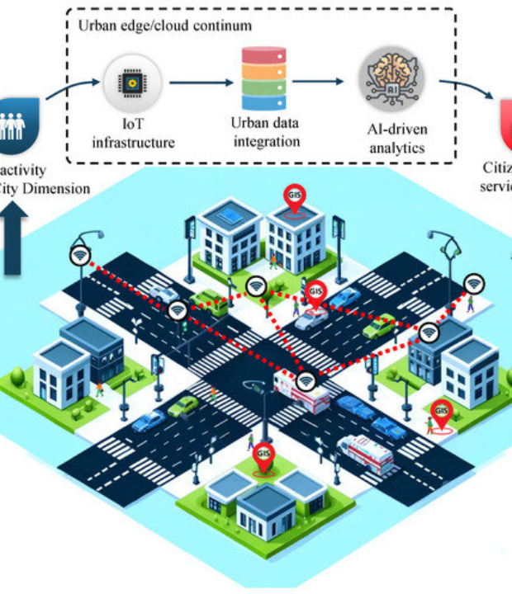


CODE FORGE
G H RAISONI SKILLTECH
Proposed Approach
Solution Concept
An end-to-end Adaptive Spatial-Temporal Graph Neural Network (AST-GNN) deployed directly on edge gateway nodes.
Major Components & Workflow
Graph Topology Learning: Dynamically maps relationship matrices between physical sensors.
ONNX Tensor Quantization: Reduces model memory size by 75% for sub-15ms edge inference.
Online Adaptive Thresholding: Continuously adjusts alert triggers to prevent false alarms.

Slide 6


CODE FORGE
G H RAISONI SKILLTECH UNIVERSITY
System Architecture
Technical Components
Security & Data Flow
Ingestion Tier: High-performance C++/Go gRPC & MQTT listeners handling 50k events/sec.
Encryption: TLS 1.3 encrypted data transit between SCADA sensors and Edge runtime.
Inference Engine: TensorRT / ONNX Runtime execution pipeline containerized via Docker.
Zero Trust: Token-based mTLS authentication across local microservice APIs.
Storage Layer: SQLite / TimescaleDB localized storage for high-speed edge telemetry logging.
Fallback Resilience: Automatic local storage buffering during network outage events.
Visualization: Lightweight WebSockets-driven React frontend & Grafana dashboards.
Hardware Isolation: Container execution sandboxing with dedicated resource quotas.

Slide 7



CODE FORGE
G H RAISONI SKILLTECH UNIVERSITY
Innovation & Impact
85%
<12ms
10x
REDUCTION IN FALSE ALERTS
EDGE INFERENCE SPEED
LOWER COMPUTE FOOTPRINT
Core Innovation
Technical Insight
What is genuinely different? Our architecture continuously self-learns inter-sensor graph structures without offline retraining, enabling true zero-maintenance edge AI deployments.
By coupling Graph Attention Networks (GAT) with dynamic quantile loss functions, the model distinguishes harmless operational shifts from genuine physical component degradation.

Slide 8





CODE FORGE
G H RAISONI SKILLTECH UNIVERSITY
Deployment & Roadmap
Target Beneficiaries
Deployment Strategy
Smart factory plant operators, energy grid managers, industrial robotics hubs, and predictive maintenance engineering teams.
Deployable via lightweight K3s/MicroK8s helm charts onto industrial edge gateways (Nvidia Jetson, Advantech IPCs).
Measurable Benefits
Moving Beyond Prototype
Estimated savings of $40k+ per machine line by preventing unscheduled breakdown hours and reducing manual inspection cycles.
Integrating native OPC-UA / Modbus protocols, securing ISO 27001 compliance, and performing hardware-in-the-loop stress testing.

Slide 9

CODE FORGE
G H RAISONI SKILLTECH UNIVERSITY
Technical References
Category | Reference Source / Technology | Utilization in Project
Research Papers | "Multivariate Time-Series Anomaly Detection via Graph Neural Networks" (AAAI 2021) | Inspiration for spatio-temporal graph attention mechanics
Open-Source Frameworks | PyTorch Geometric (PyG), ONNX Runtime, C++ gRPC Core | Graph neural network training & high-speed edge inference engine
Industry Standards | OPC-UA Telemetry Spec & IEEE 1451 Smart Sensor Architecture | Data ingestion normalization and industrial protocol mapping
Benchmark Datasets | SWaT (Secure Water Treatment) & WADI Industrial Testbeds | Model training, validation, and multi-sensor drift simulation

Slide 10



CODE FORGE 2026
G H RAISONI SKILLTECH UNIVERSITY
Thank You!
Ready for Questions & Discussion
Team Smasherz | Problem Code: CF-26 S-03
GitHub Repository
GHRCEM Nagpur

